Slide 2
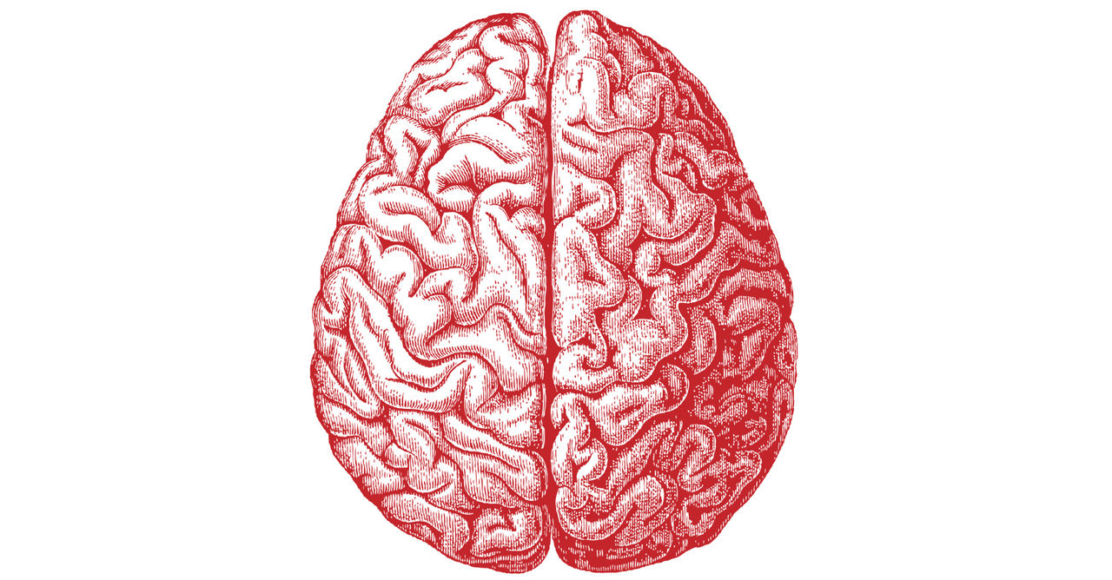
Language: An Overview
Language is a brain function
Studying language helps us learn about:
The brain regions responsible for language
What goes wrong in language disorders
Language is located in the left hemisphere of the brain
How do we know this?
Notes:
One of the most prominent human abilities is language, a complex system involving many components.
Studying language helps us learn about the brain regions responsible for language, and what goes wrong in language disorders.
Language is located in the left hemisphere of the brain.
How do we know this?

Slide 3
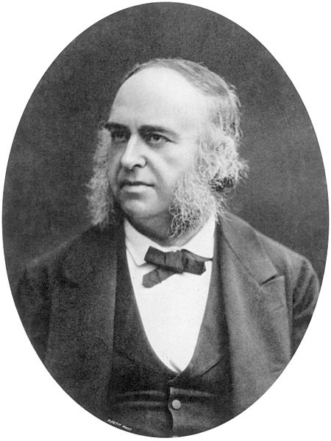
Patient Tan
In 1861, a French physician named Pierre-Paul Broca met a 51-year-old man who was lying on his deathbed.
Louis Victor Leborgne, who had come to the hospital 21 years earlier, was paralyzed on the right side of his body, and could only speak a single syllable – “tan.”
After Leborgne’s death, Broca examined his brain and discovered a mysterious lesion in the left frontal lobe
Broca’s theory: the lower part of the frontal lobe of the brain was responsible for what we now call speech production
published in the US before 1923 and public domain in the US.
Notes:
In 1861, a French physician named Pierre-Paul Broca met a 51-year-old man who was lying on his deathbed in a hospital for the mentally ill. Louis Victor Leborgne, who had come to the hospital 21 years earlier, was paralyzed on the right side of his body, suffered from advancing gangrene, and could only speak a single syllable – “tan.”
Fellow patients and doctors referred to Leborgne as Patient Tan.
Leborgne died a few days after meeting Broca, but not before giving his permission for the hospital to perform an autopsy.
While examining Leborgne’s brain, Broca discovered a mysterious lesion in the left frontal lobe and wondered whether this was the cause of Leborgne’s speech deficit.
Broca’s theory was that this part of the frontal lobe – the lower part of the frontal lobe of the brain – was responsible for what we now call speech production.
These two cases helped Broca to really launch the idea that there are brain regions that can support specific kinds of functions like language and cognition.

Slide 4
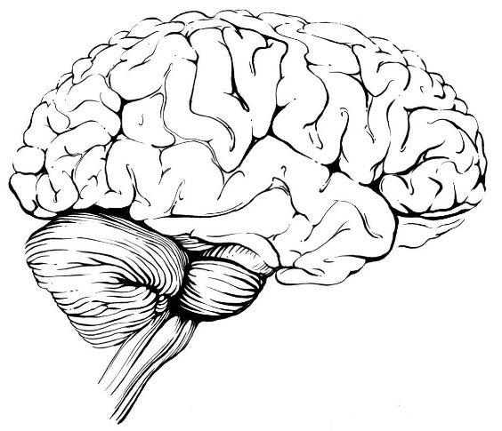
Aphasias
Damage to different regions within the left hemisphere produces different kinds of aphasias
Aphasias: language disorders
Broca’s aphasia, a syndrome in which speech production abilities are impaired
Wernicke’s aphasia, a syndrome in which comprehension of heard speech is impaired
Notes:
Although language is not fully understood, scientists have learned a great deal about this brain function from studies of patients who have lost speech and language abilities as a result of a stroke.
It has long been known that damage to different regions within the left hemisphere produces different kinds of language disorders, or aphasias.
Damage to the left frontal lobe can produce nonfluent aphasias, such as Broca’s aphasia, a syndrome in which speech production abilities are impaired.
Speech is slow and halting and often lacks complexity in word or sentence structure.
Damage to the left temporal lobe can produce fluent aphasia, such as Wernicke’s aphasia.
Speech, although of normal fluency and speed, is often riddled with errors and word selection tends to be gibberish.

Slide 5
Language and Speech Disorders
Damage to the superior temporal lobes in both hemispheres can produce word deafness
a profound inability to comprehend auditory speech on any level
Recent work has also identified a sensory-motor circuit for speech in the left posterior temporal lobe
This circuit is involved in speech development and is thought to support verbal short-term memory
Stuttering, once thought to be purely a stress response, has now been linked to abnormalities in brain connections
Notes:
Damage to the superior temporal lobes in both hemispheres can produce word deafness, a profound inability to comprehend auditory speech on any level.
Whereas Wernicke’s aphasics can often comprehend bits and pieces of a spoken utterance patients with word deafness lack the ability to comprehend even single words despite being able to hear sound.
Recent work has also identified a sensory-motor circuit for speech in the left posterior temporal lobe, which is thought to help the systems for speech recognition and speech production communicate with each other.
This circuit is involved in speech development and is thought to support verbal short-term memory.
Once thought to be purely a stress response, stuttering has now been linked to abnormalities in brain connections.

Slide 6
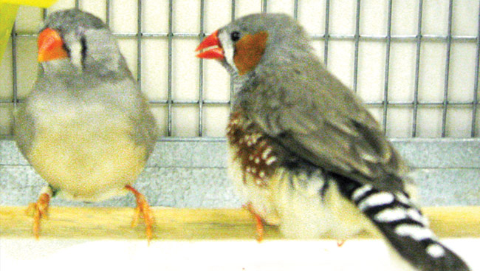
How We Study Language
We are not the only animals to communicate with one another
Research on songbirds is shedding light on how children learn to speak
Like a child learning to speak, a songbird must hear vocal sounds of adults during a critical period and then hear its own voice when learning to imitate those sounds
Notes:
We are not the only animals to communicate with one another.
Songbirds are teaching researchers a lot about the human brain. For instance, research on songbirds is shedding light on how children learn to speak.
Young songbirds learn to vocalize by listening to adult members of their species. Like a child learning to speak, a songbird must hear vocal sounds of adults during a critical period and then hear its own voice when learning to imitate those sounds.

Slide 7
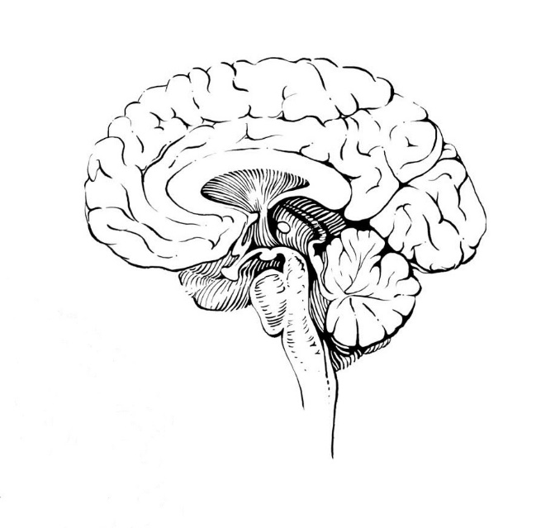
How We Study Language (cont.)
Children progress from babbling to speaking and songbirds progress from chirping to singing with practice
In humans and songbirds, similar networks of brain structures are involved in motor learning
Basal ganglia
Notes:
Vocal learning requires sensory feedback so individuals can adjust and perfect their performances. Children progress from babbling to speaking and songbirds progress from chirping to singing with lots of practice, practice, practice.
In humans and songbirds, similar networks of brain structures are involved in motor learning. Like humans, songbirds possess a group of brain structures that together are called the basal ganglia.
The basal ganglia receives information from cortical regions of the brain and passes it on to other brain structures, forming a circuit that is important for learning and controlling movements.
By tracking down how the songbird brain generates these different vocal behaviors, researchers are learning a great deal about what limits or enables motor learning throughout life.

Slide 8
Language and the Brain
This presentation was developed from the following articles from the Sensing, Thinking & Behaving section of BrainFacts.org:
Language: An Overview
Language and the Brain: What Makes Us Human
Birdsong
Struggling to Speak: The Brain Map of Patient Tan

Slide 9
Thank You
Explore the Brain and Mind
Follow BrainFacts.org
@Brain_Facts_org
https://www.facebook.com/BrainFactsOrg

