Slide 2
The Heart vs The Brain
Emotions

Slide 3
Mission Control for Emotions
Many authors have written about heartbreak, and many movie characters have died of a broken heart.
Directors add long pauses in between scary scenes to quicken viewers’ heartrates.
Commercials play slow music behind sad images hoping you will have a change of heart and donate to their cause.
When your sibling steals your clothes you feel your chest tighten and your heart beat faster as you grow angry.
But is your heart really in charge of all these emotions?

Slide 4
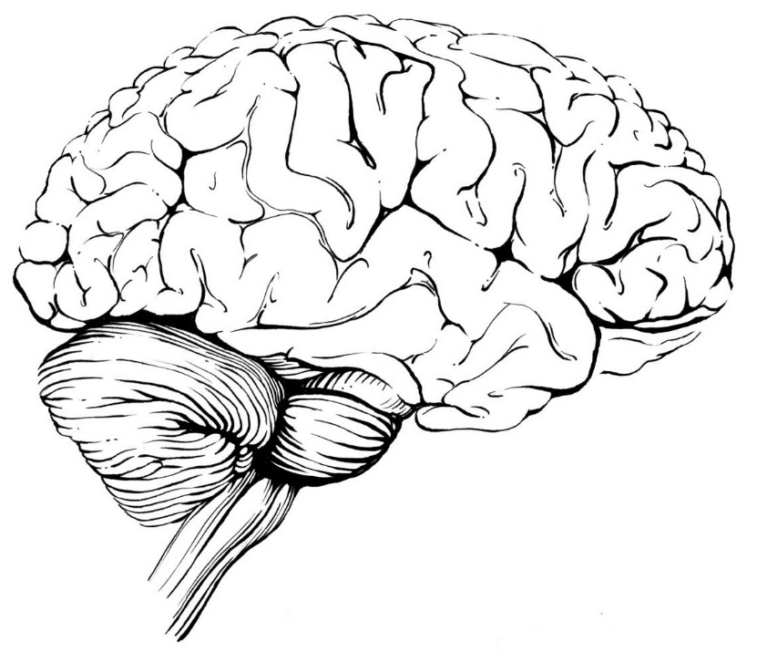
Emotions are regulated by the brain

Slide 5
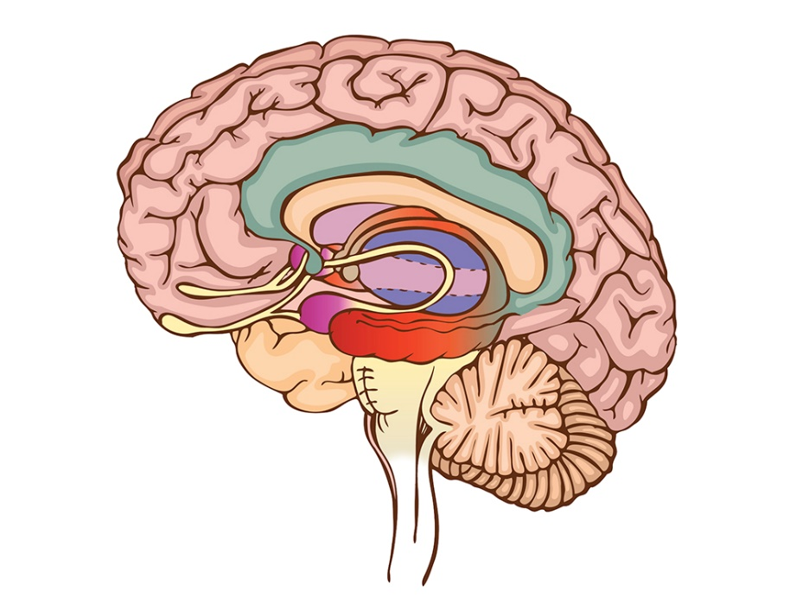
The Limbic System and Emotions
The limbic system is located in the center of the brain, and it acts as the brain’s emotional control center.
The limbic system is made up of many parts including the hippocampus, amygdala, thalamus, hypothalamus, basal ganglia, and cingulate gyrus.
The hippocampus is a seahorse-shaped structure involved in learning, memory, and emotion.
The amygdala plays a central role in emotional learning, particularly fearful memories.

Slide 6
Fear
“Fear is the path to the Dark Side. Fear leads to anger, anger leads to hate, hate leads to suffering.” –Star Wars Episode I: The Phantom Menace, 1999
The amygdala has been identified as the brain’s “fear center.”
The amygdala is an almond-shaped bundle of neurons buried deep in each temporal lobe.
When you sense something potentially dangerous the amygdala sends excitatory signals to other parts of the brain telling it to be on alert.

Slide 7

Aggression
“Aggression is different from anger. Anger is an emotion; aggression is a behavior.” – Growing Into Soul
Low levels of the chemical serotonin, particularly in the prefrontal cortex, play a large role in aggressive behavior.
Mice demonstrate aggression by physically dominating other mice repeatedly.
Being the recipient of an aggressive social encounter can cause changes in the brain that lead to depression and anxiety.
  Animal research shows that aggressors may suffer from many of these same effects.

Slide 8
Love
“Love looks not with the eyes, but with the mind” –William Shakespeare, "A Midsummer Night's Dream | Act 1, Scene 1”
Researchers scan the brains of people in love and find the ventral tegmental area (VTA) is most active.
The VTA is part of the brain’s reward pathway which is responsible wanting, craving, and obsession.
  The reward pathway releases the hormone oxytocin, which appears to cement bonds between adults and helps promote fidelity within monogamous relationships.

Slide 9
Activity
Using your notes, fill in the blank brain worksheet.
First, label the amygdala, the prefrontal cortex, and the Ventral Tegmental Area (VTA).
Next, label what emotion each area of the brain regulates.
Finally, list three examples of each emotion on the lines provided.
  Examples:
    Fear: Hearing a loud noise when you’re home alone
    Aggression: Road rage

Slide 10

Follow BrainFacts.org
@Brain_Facts_org
https://www.facebook.com/BrainFactsOrg

